Slide 1
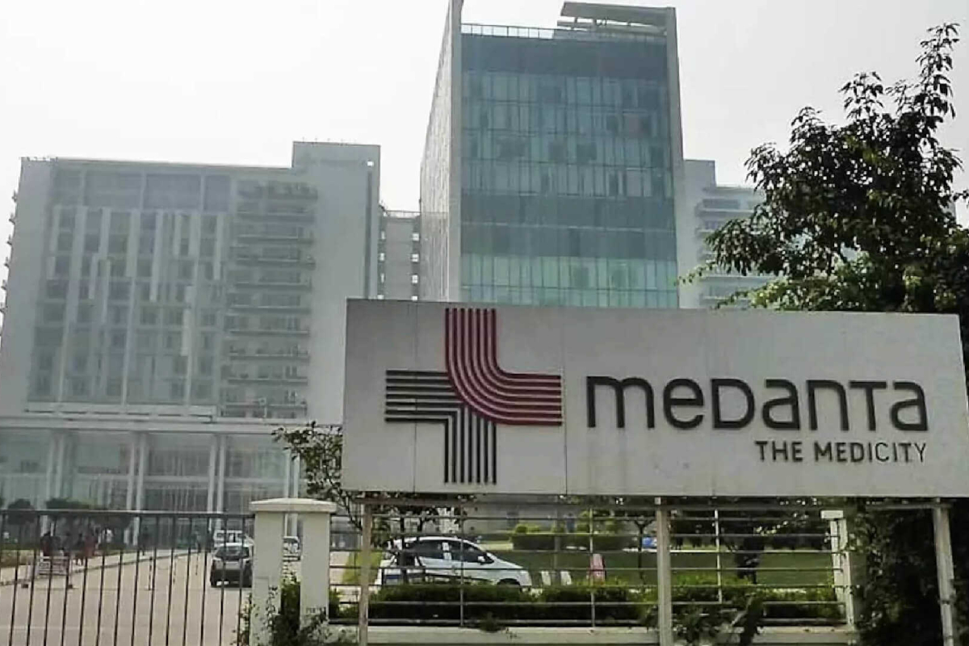
KEY STRATEGIC CONCEPTS OF
INDIAN HOSPITALS
CHRISTYANA A
RA2352010010003
MBA HEALTHCARE AND
HOSPITAL MANAGEMENT

Slide 2
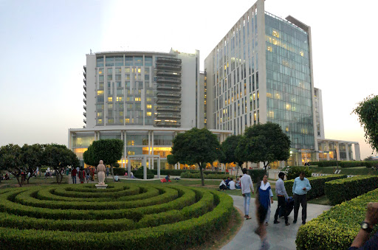




INTRODUCTION
Medanta - The Medicity is a leading healthcare provider in India, renowned for its state-of-the-art facilities, world-class medical expertise, and commitment to patient care. Medanta follows a functional organizational structure, dividing its operations into specialized departments
Medanta is currently in the maturity stage of its life cycle. It has established a strong market presence, a loyal customer base, and a stable revenue stream. However, to sustain its growth and competitiveness, Medanta must continue to innovate and adapt to changing market dynamics.
https://www.medanta.org/about

Slide 3







STRATEGIES
01
02
Planning
Competitive
03
04
05
Analysis
Execution
Growth

Slide 4
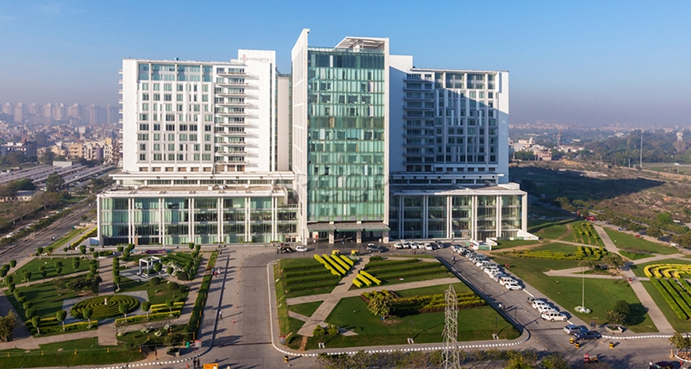




SWOT ANALYSIS
Strengths
Weakness
Opportunities
Threats
Strong brand, experienced doctors, advanced facilities, patient-focused care.
Dependence on key doctors, operational inefficiencies, growth challenges.
Expansion, international partnerships, technology advancements.
Economic downturns, regulatory changes, competition.

Slide 5

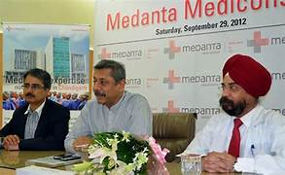


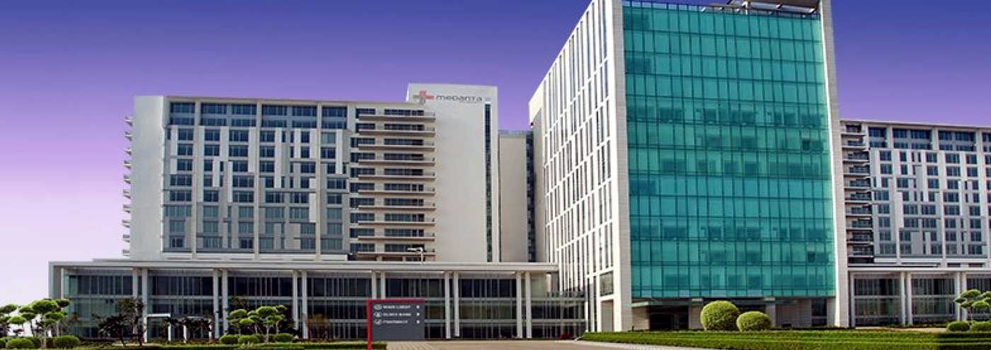
COMPETITIVE STRATEGIES
Differentiation
Cost Leadership
Focus Strategy
Medanta differentiates itself through its world-class facilities, specialized expertise, and personalized patient care.
While not strictly a cost leader, Medanta strives for operational efficiency and cost-effective practices.
Medanta focuses on specific market segments, such as international patients and high-end healthcare services.

Slide 6
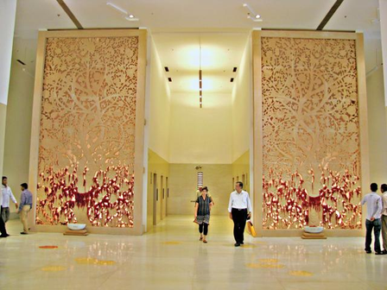



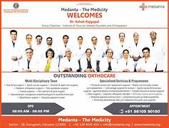

IMPLEMENTATION
Diversification
Partnerships
Expanding into new geographic locations and offering a wider range of healthcare services.
Collaborating with international healthcare providers and research institutions to enhance expertise and access to advanced technologies.
Technology Adoption
Brand Building
Investing in cutting-edge medical equipment and digital health solutions to improve patient care and efficiency.
Strengthening Medanta's brand image as a trusted and reliable healthcare provider through marketing and public relations efforts.

Slide 7



OUR TEAM
Medanta's strategies have had a significant impact on the organization:
Increased Market Share: Diversification and expansion have helped Medanta capture a larger market share.
Enhanced Expertise: Partnerships have provided access to specialized knowledge and resources.
Improved Patient Care: Technology adoption has led to more accurate diagnoses, faster treatment times, and better patient outcomes.
Stronger Brand Reputation: Effective branding has solidified Medanta's position as a leading healthcare provider.

Slide 8
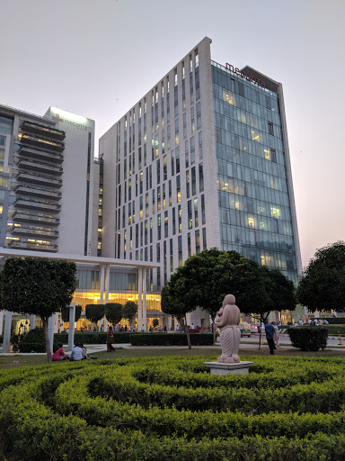



STATISTICS
80%
20%

Slide 9
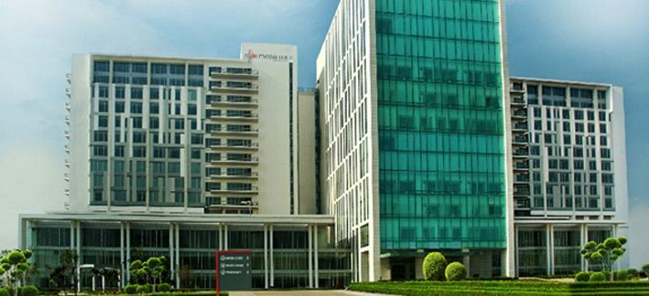
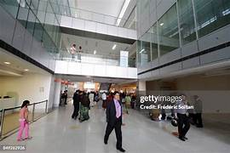

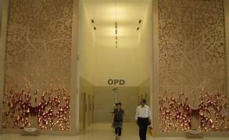
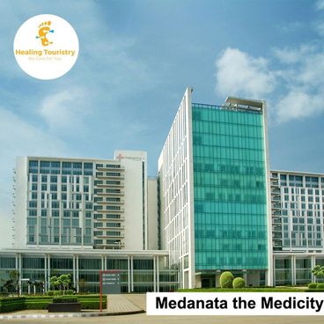
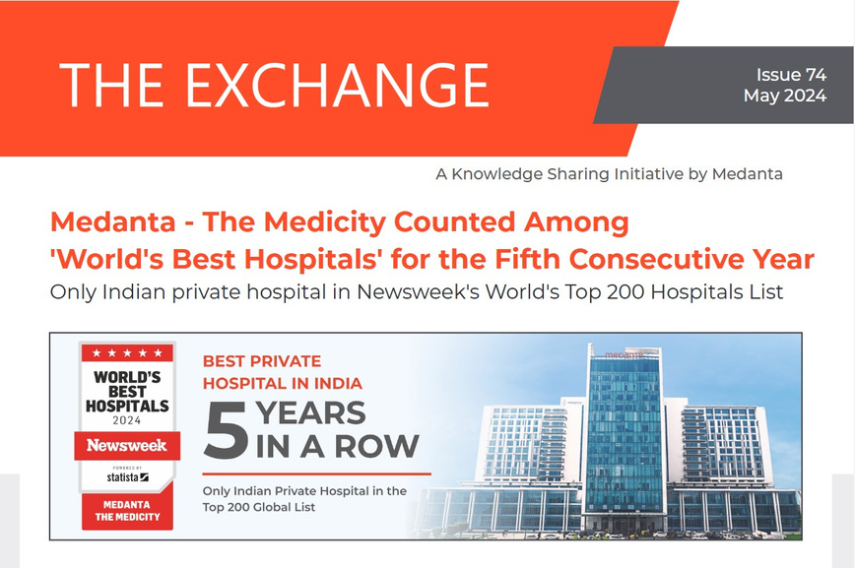
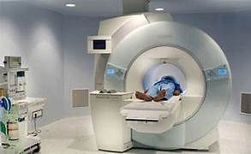

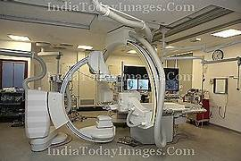

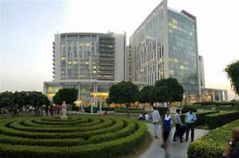

Slide 10

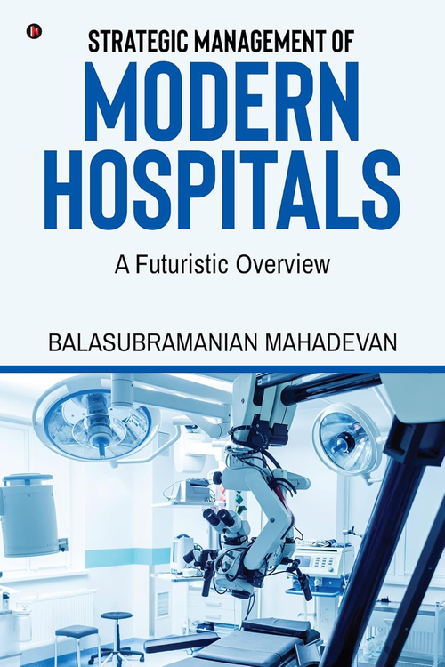
STRATEGIC MANAGEMENT OF MODERN HOSPITALS:
A FUTURISTIC OVERVIEW
By BALASUBRAMANIAN MAHADEVAN
Strategic Framework: The book emphasizes the need for a strategic framework for modern hospitals, given the rapid advancements in technology and healthcare.
Technology Integration: It explores the integration of technology into hospital operations, including AI, IoT, and telemedicine.
Patient Experience: The importance of patient experience is highlighted, focusing on factors such as accessibility, affordability, and quality of care.
Healthcare Economics: The book delves into the economic aspects of healthcare, including cost-effective practices and sustainable business models.
Leadership and Management: It emphasizes the role of effective leadership and management in driving innovation and ensuring the success of hospitals.
Overall, the book provides a comprehensive overview of the challenges and opportunities facing modern hospitals and offers practical insights for strategic planning and management.

Slide 11

A Review of the Use of Strategic Management Tools in the HealthSector
Authors
Alim, Dani Sahirul; Wening, Nur
Publication
Indian Journal of Forensic Medicine & Toxicology, 2021, Vol 15, Issue 4, p975
AIM:
This paper is a review and study of various research related to tools of strategic, and factors that influence both of internal and external strategic in medical facilities research.
The purpose of the review is to explore and connecting theories from various research. This paper identified 51 articles with related topics published the last decade.
TOOLS USED:
The use of SWOT (strengths weaknesses opportunities threats) analysis is the most popular tool used (42.86%), followed by Break-even analysis (28.56%), Balanced scorecard (BSC) and PEST (political, economic, socio-cultural, technology) each (14.29%). Based on the analysis of environmental factors related to internal factors in the health facility amount of 33.33%. External environmental factors in health facilities that have been studied amounted to 66.66%.
RESULT:
Based on the summary of research related to internal and external, it is known that industry environment factors and rivalry environment factors are still rarely studied. The general environmental factors of demography and epidemiology are still rare studies and have the opportunity to be researched and developed.
https://openurl.ebsco.com/EPDB%3Agcd%3A12%3A22829484/detailv2sid=ebsco%3Aplink%3Ascholar&id=ebsco%3Agcd%3A153355886&crl=c

Slide 12
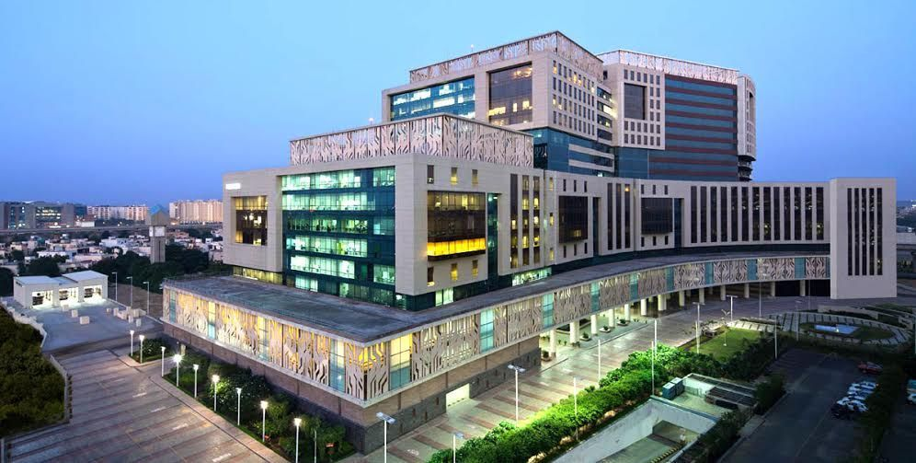
THANK'S FOR WATCHING

